Slide 1


Slide 2



Slide 3






Slide 4

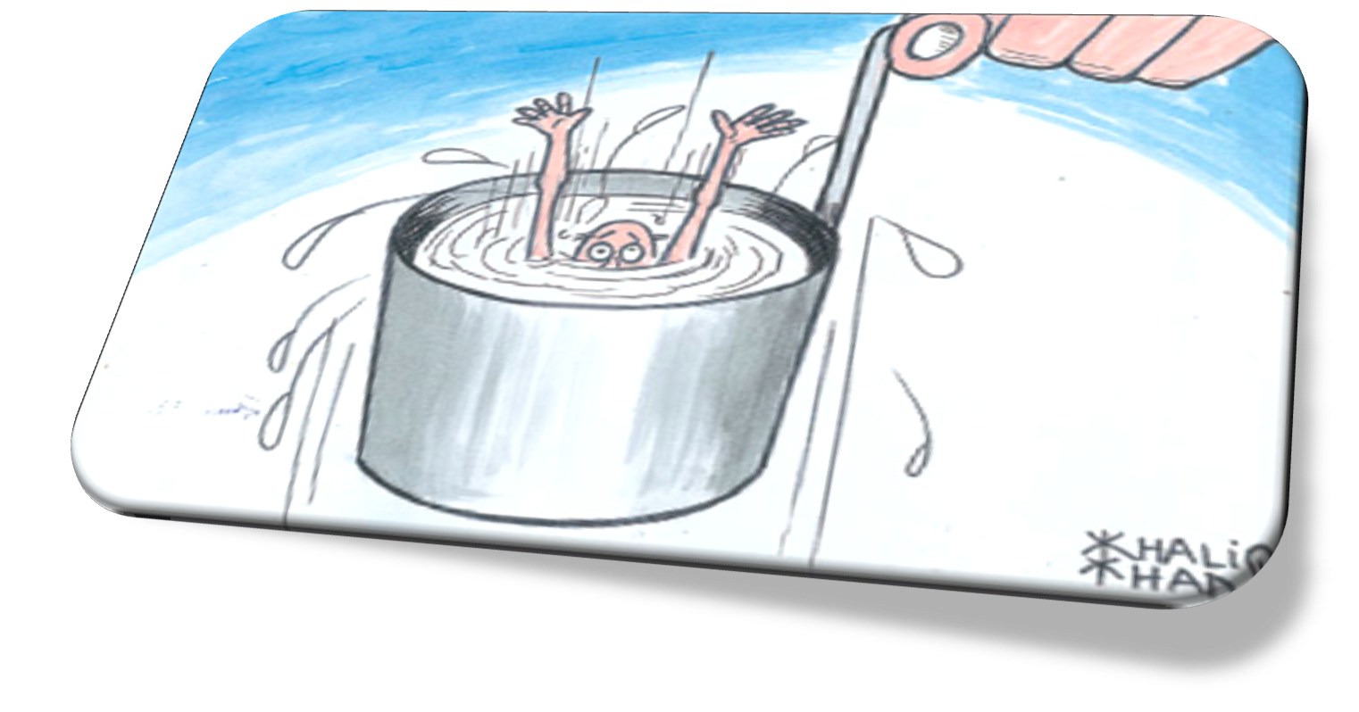
Pakistani(Lahore) Film Industry “Downfall”

Slide 5


Pakistan is in a very severe stipulation, Economy is undergoing a rigorous situation. Film industry plays a vital role in generating the huge revenues. But, unfortunately Pakistani film industry is facing overwhelmingly crises & problems.

Slide 6



Justification Of Problem
year | Films per year
1991 | 94
2007 | 41
year | Cinema houses
1973 | 272
2005 | 126
Substandard movies, vulgar dances, Repetitive themes, too much violence & unrealistic story line of all movies.
Do not keep pace with changing taste, mindset & latest technology , so, filmmakers do not have much distinguish to offer.
Industry does not have a potential to recognize itself on international level.
So, these above but not least factors lead to downfall of film industry.

Slide 7











Theoretical Framework
Dependent Variable
Moderating Variable
Independent Variable

Slide 8

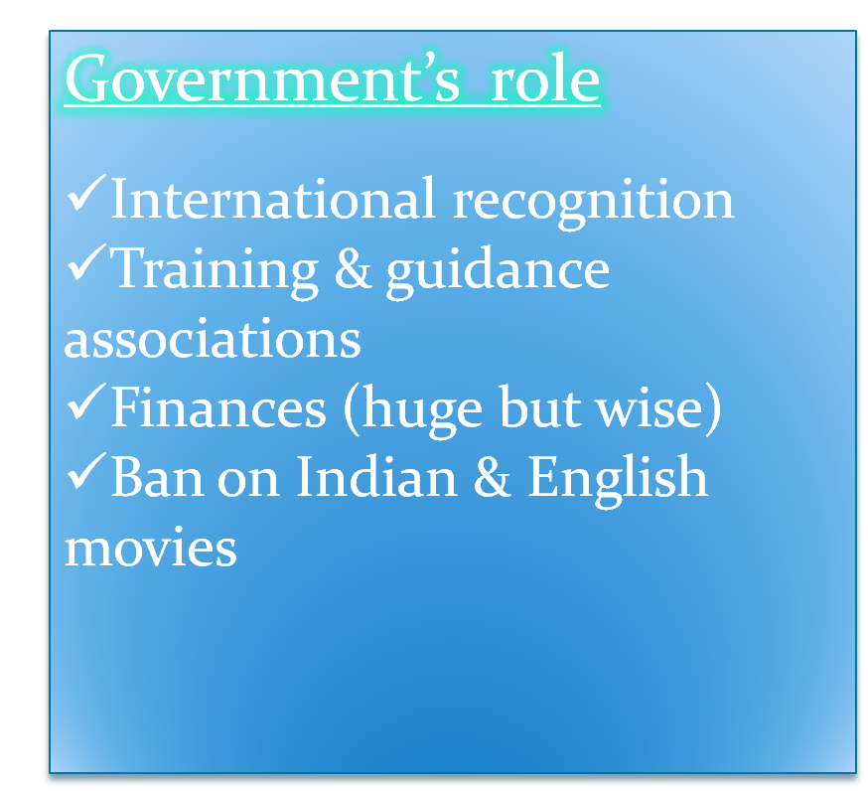


Slide 9


Substandard Quality of Films
Mostly, movies are made on unrealistic love and action line and on repetitive titles, and in these films vulgar dances are the key factors for declining of film industry. So, people want to see Indian movies rather than to see Pakistani movies.

Slide 10

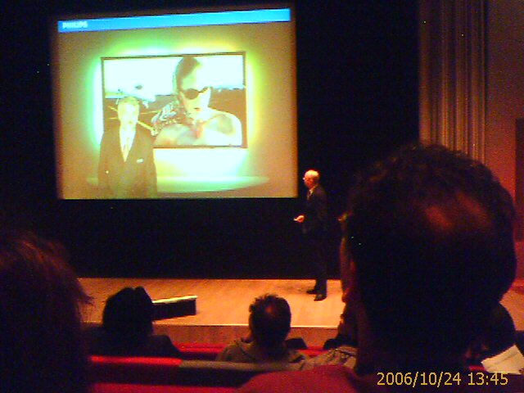

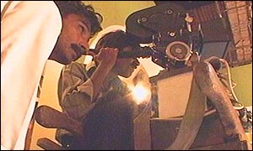
Technological Infrastructure
There is very deprived technology available to make films, when music quality as well as video prints are concerned. Because picture quality and sound does matter, as in Pakistan(Lahore), only Empire, Metro pool and Gulistan cinemas have digital track sound systems.

Slide 11
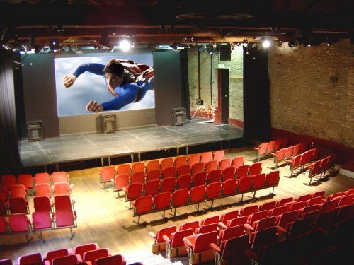
Number of Cinema
750 Cinemas in Pakistan before 90’s
Right now only 250 Cinemas left
  Karachi
  Lahore
  Rawalpindi
  Quetta
  Peshawar

Slide 12

Critics Comments
Laila Zuberi
They critize on bad condition of cinemas and low standard of Pakistani films. Repetitive themes, too much violence and vulgarity have forced the families to stop watching films
Nasir Adeeb
producers are not paid handsomely to the scrip writer only a few producers and directors agree to buy a well written script,

Slide 13
Critics Comments Cont…
Jahanzaib Baig
He said that a cinema needed 35 to 40 films to screen in a year. Our problem is not the quality We want the product that we lack. Only a good picture will do business
Agha Nasir
weak scripts, Piracy and cable television are significant factors contributing to the decline of cinema in Pakistan he also said that the government is not responsible for cinema's decline.

Slide 14
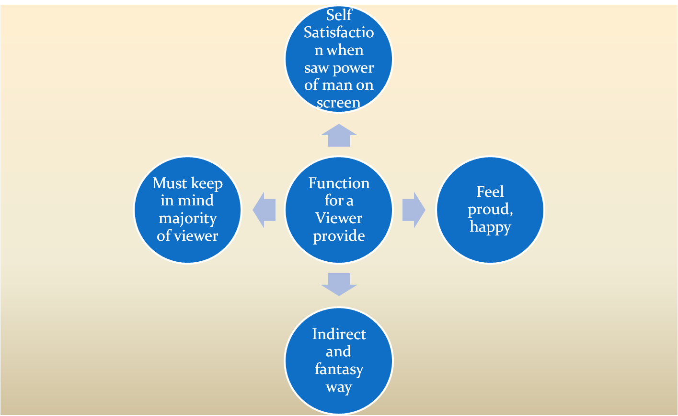
What sort of Function these films provided for viewer

Slide 15



Slide 16

Illogical Love Stories
Illogical love stories have destroyed the image of the sensible and light love stories which could be watched by families
This trend if changed will encourage families to go to the cinema and watch Pakistani films.

Slide 17

Latest Technology
The technology used in making the film is old and as a result the final print is not a standardized print
As a result it do not leave a good impression on viewers and thus is an obstacle in attaining viewership across the country
Unless latest technology is used, the quality cannot be improved

Slide 18

TAX Benefits
Reduced TAX
Or Exempted initially
Act as a cushion to the sinking industry

Slide 19

Niche Targeting
Niche marketing or niche targeting of healthy ( People who want to see good films other than vulgarity and violence.)

Slide 20
A Platform for new talent should be established
There is no platform in the country for youngsters to become new directors
As a result the old hands are making films with rigid ideas which are not doing business any more
If a new youngster turns into a film director he will bring new innovative ideas into the field

Slide 21

Script Writing
Proper attention should be given towards script writing and the definition of roles in the film.
Film industry can be re tracked on its path to glory only if the script is strong , realistic and such which should address and project the issues of our society

Slide 22
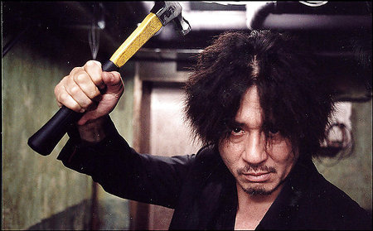
Unnecessary Violence
The unnecessary violence must be kept aside, the canal of blood seems to be an imperative part of the films today

Slide 23

Definition of ROLES
The defining of roles is critical in any successful hit. Ordinary focus is kept on defining the roles
Secondly, the role defined to female is mostly pathetic and this phenomenon should be changed

Slide 24

Poor Action Scenes
The drastically poor and over action moves are a tradition and identity of our film industry
These odd looking so called action movies can be called the high action hits in may be the age of stone
Some sense should be included while designing the action scenes

Slide 25
Repeated Themes
Repeated theme is one of the reason that lead to the flop of films
Instead of following already used theme, new ideas must be focused to make films on.

Slide 26

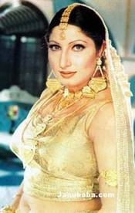
Repetition of Pairs
Excessively repeated combination of a specific hero and heroin irritates the viewers as it contains a pattern of similarity in the acting
Instead new combinations should be used to introduce the change in acting patterns
People are sick of seeing Shan and Saima in every film

Slide 27

Focus on Screen Play and Script
Our directors are paying their prime attention towards Glamour
Instead of focusing on glamour only, the focus must also be kept over screen play and script writing

Slide 28
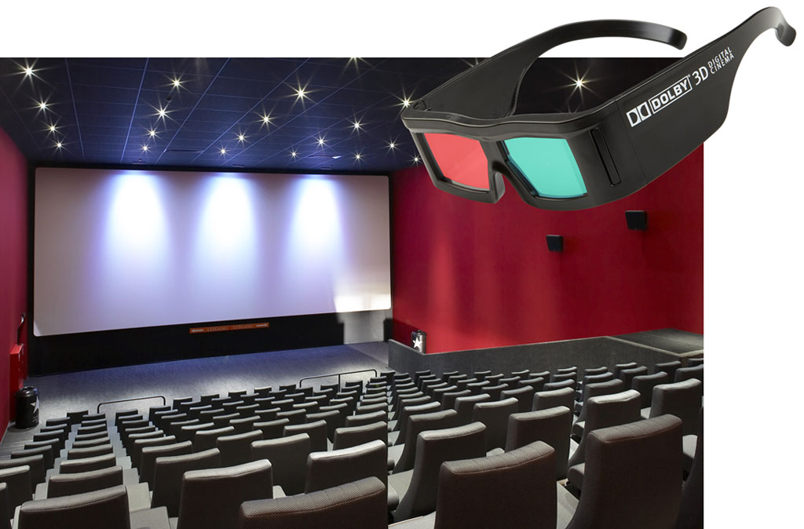
Multiplex Cinemas
Multiplex Cinemas have been running successfully throughout the world
If you go to see a movie in the traditional cinema houses, you would feel very bad. These cinemas are in a pathetic condition
We need to replace the existing cinemas with these state-of-the-art cinema houses

Slide 29
Names of Films
Specially curved names targeting specific casts and some irrational words have diluted he fame of Pakistani films
Rational names irrespective of any cast targeting could also help the Pakistani Films to gain popularity

Slide 30


